Slide 1
BARANGAY ANTI-DRUG PLAN OF ACTION (BADPA) FORMULATION
DILG Memorandum Circular No. 2022-141

Slide 2
Anti-Drug Plan Of Action
Refers to the list of activities and efforts of provinces, cities, municipalities, and barangays to strengthen their campaign against illegal drugs. ADPA is anchored in Republic Act No. 9165 or the Comprehensive Dangerous Drugs Act of 2002, which embodies the National Government’s commitment in eradicating the country’s illegal drug problem.

Slide 3
BARANGAY ANTI-DRUG PLAN OF ACTION (BADPA) PLANNING AND IMPLEMENTATION PROCESS

Slide 4
Barangay Anti-Drug Plan Of Action
The BADAC shall formulate a three-year term base plan for the anti-illegal drug activities;
The BADAC shall come up with a BADPA summary which includes the formulated strategies, identified policies, programs, projects, services, and activities (PPPSAs), and the calculated funding requirements;

Slide 5
Barangay Anti-Drug Plan Of Action
The BADAC shall then issue a Resolution approving the BADPA and for its endorsement to the Barangay Development Council (BDC), for inclusion of PPSAs to the Barangay Development Plan (BDP).

Slide 6
Barangay Anti-Drug Plan Of Action
Considering that problems on illegal drugs is merely a component of Peace and Order, the BADPA must be integrated in the Barangay Peace and Order and Public Safety (BPOPS) Plan

Slide 7
Fund Allocation
To ensure the funding for the activities cited under the BADPA, the Sangguniang Barangay shall appropriate a substantial portion of their annual budget to assist and/or enhance the enforcement of the anti-illegal drugs initiatives.

Slide 8
Fund Allocation
Once included in the BDP, the BADPA shall be incorporated in the BDIP which shall be used as basis of the AIP and annual budget.

Slide 9
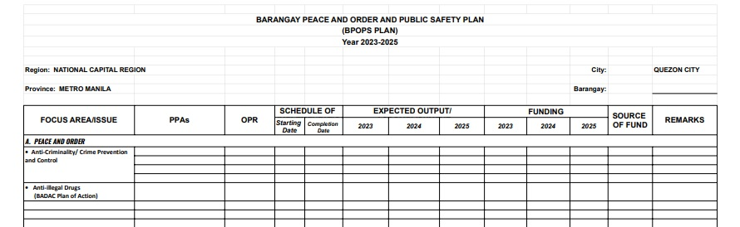

Slide 10
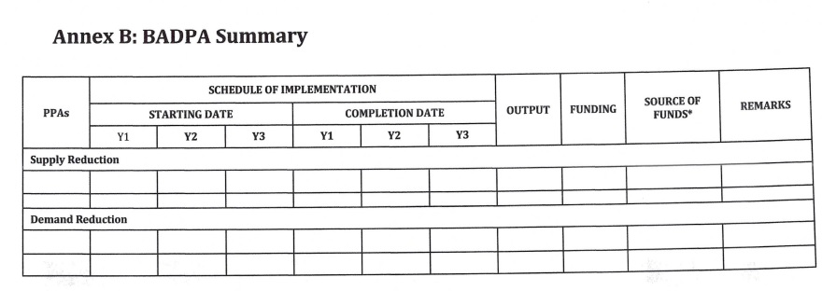

Slide 11
ACTIVITY | SCHEDULE
Submission of Barangay Data regarding anti-illegal drug situation and assessment of previous implementation of BADPA | September 2022
Prioritization of anti-illegal drug issues and challenges
Preparation and submission BADPA Summary | January to May 2023
Issuance of BADAC Resolution approving the BADPA

